Slide 1
VECTOR’S DOT MATRIX BOARD

Slide 2
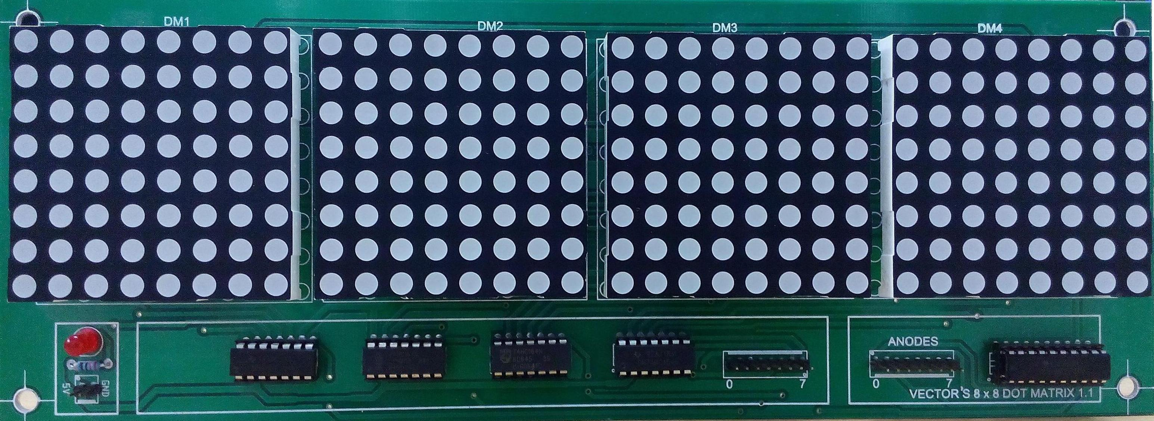

Slide 3
INTERFACING
Four dot matrix display’s interface with the help of four shift registers and one latch
Each shift register – 2 i/p’s and 8 o/p’s
(74HC164 – SHIFT REGISTER)
For latch 8 i/p’s and 8 o/p’s
(74HC573 - LATCH)

Slide 4
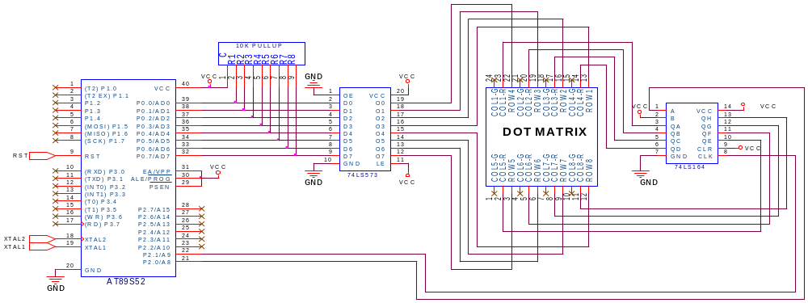
SINGLE DOT MATRIX SCHEMATIC

Slide 5
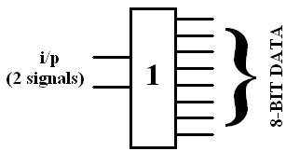
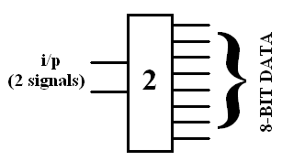
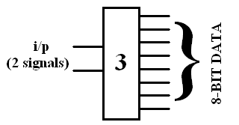
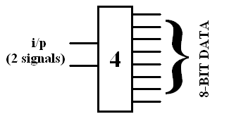
SHIFT REGISTERS

Slide 6

LATCH

Slide 7
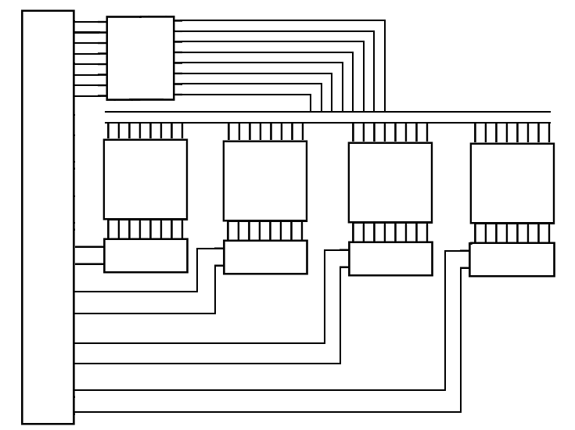
74HC573
(LATCH)
ANODES
A
T
8
9
S
5
2
8-BIT DATA BUS
8X8 DOT MATRIX DISPLAY 1
8X8 DOT MATRIX DISPLAY 2
8X8 DOT MATRIX DISPLAY 3
8X8 DOT MATRIX DISPLAY 4
74HC164_1
74HC164_2
74HC164_3
74HC164_4
SHIFT REGISTERS
Notes:
ANODES

Slide 8


Slide 9
THANK YOU
Notes:
SHIFT REGISTERS

